Slide 1

Mobile Application Development
Workshop

Slide 2

Who we are…?

Slide 3
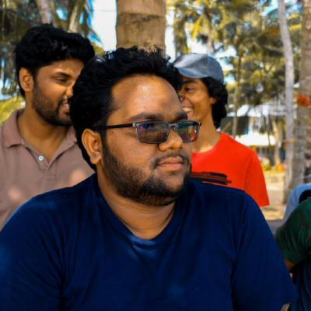
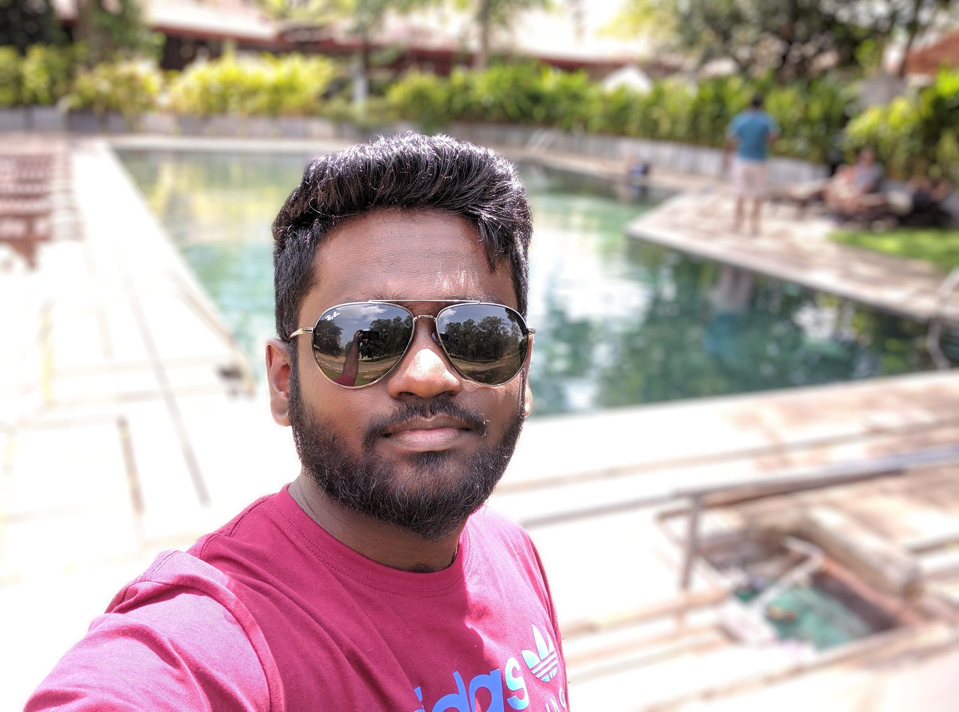
Chathura Hettiarachchi
Associate Tech Lead
Frontend, backend & mobile developer
Android, iOS, ReactJs, RoR, .NET, NodeJS, Python, Team Lead & open source contributor
Nimantha Lakshan
Software Engineer
Mobile & Java developer
Android, iOS, Java SE, Java EE
Shasika Jayawardene
Software Engineer
Mobile developer
Android, iOS

Slide 4
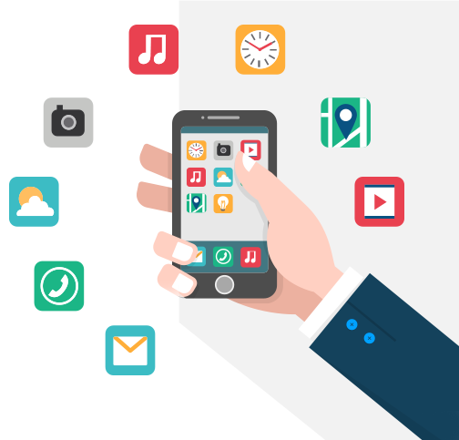
Why mobile
applications?
1
The reason to use mobile application?

Slide 5
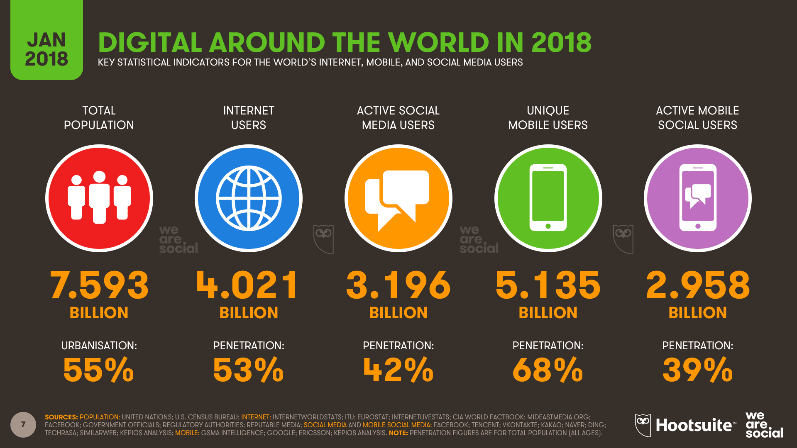

Slide 6
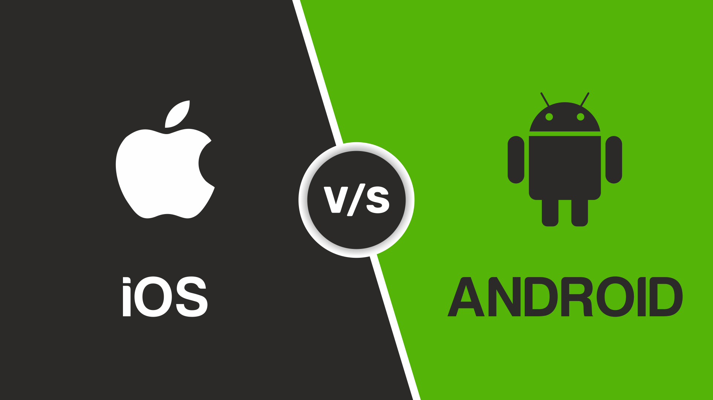

Slide 7


Slide 8
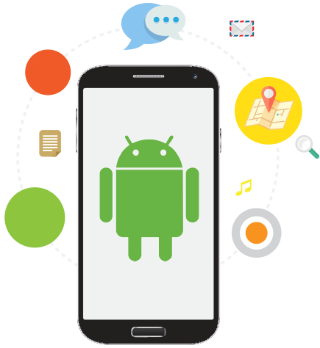
Where We Can
Use
Android?
Tv, watches to everything if it has a screen

Slide 9
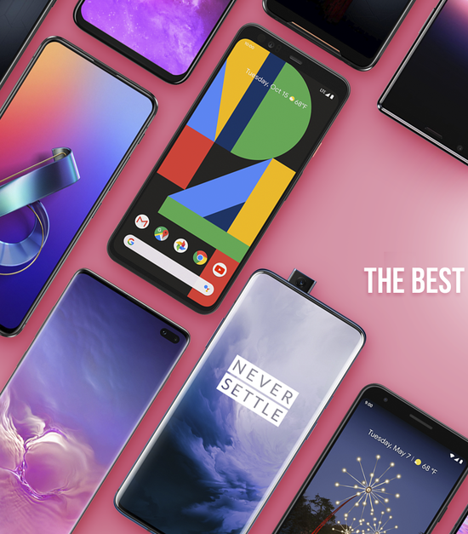
Android Mobile Phones

Slide 10
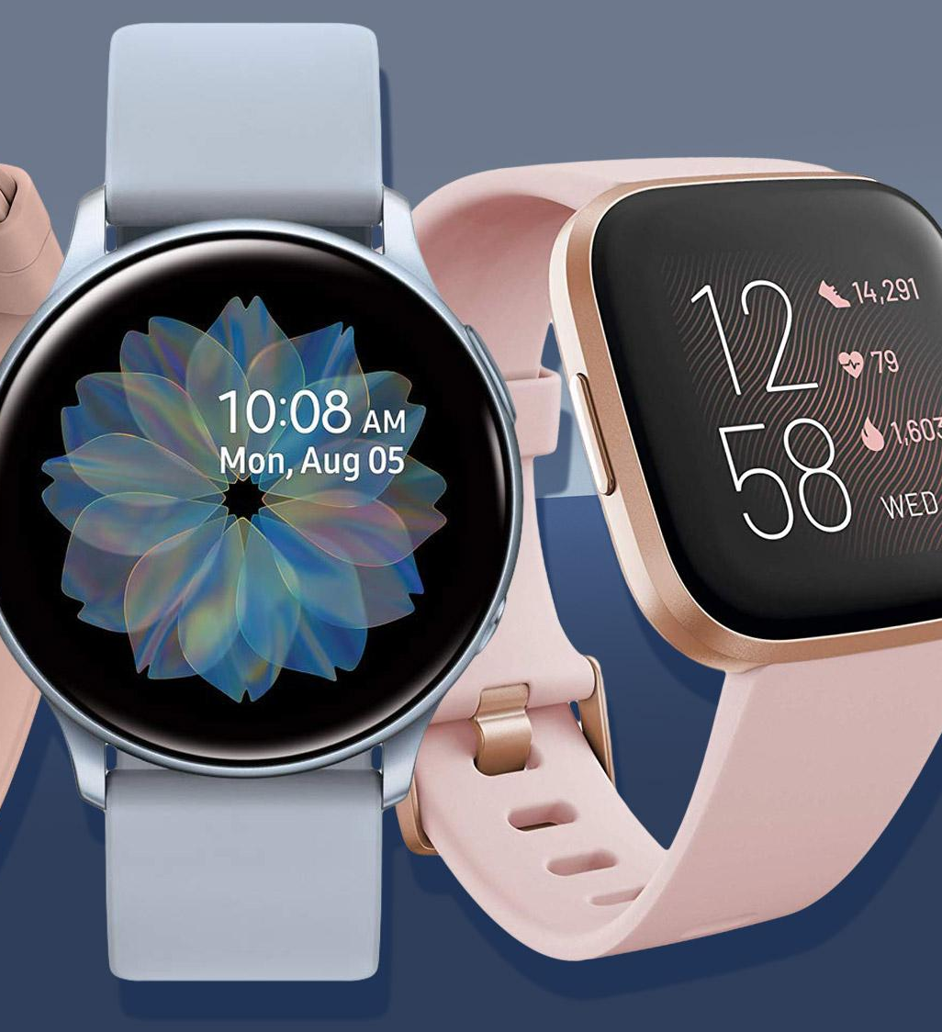
Smart Watch

Slide 11
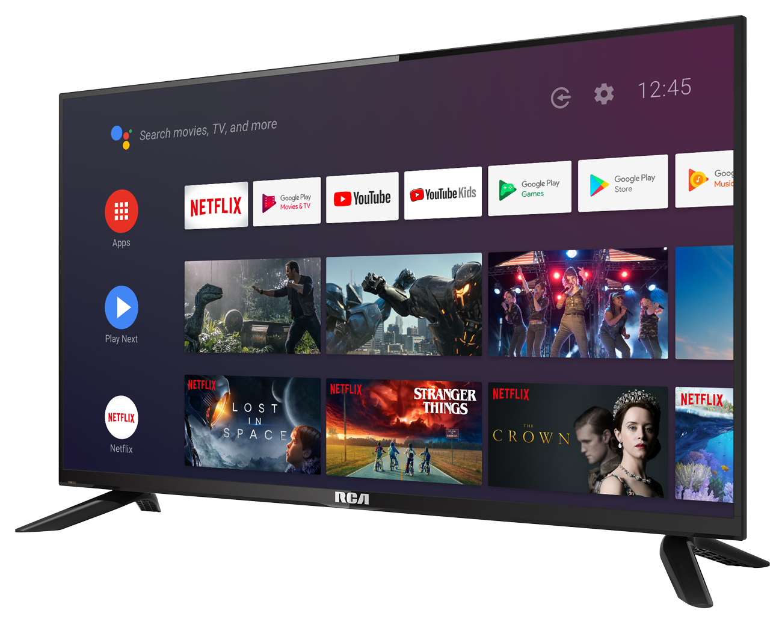
Smart TV

Slide 12
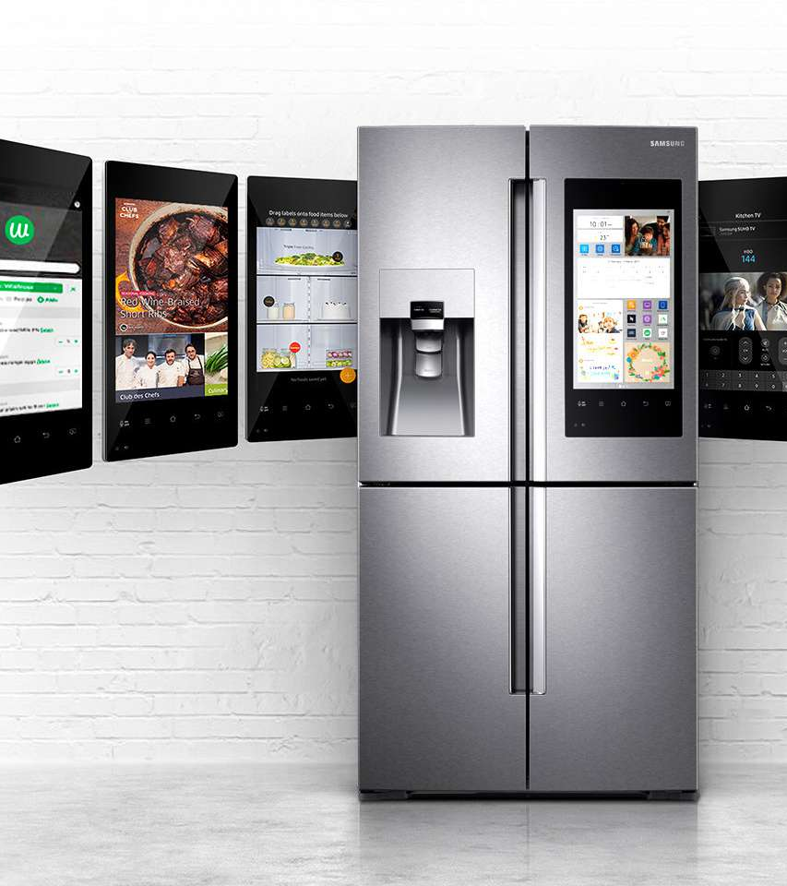
Smart Refrigerators

Slide 13
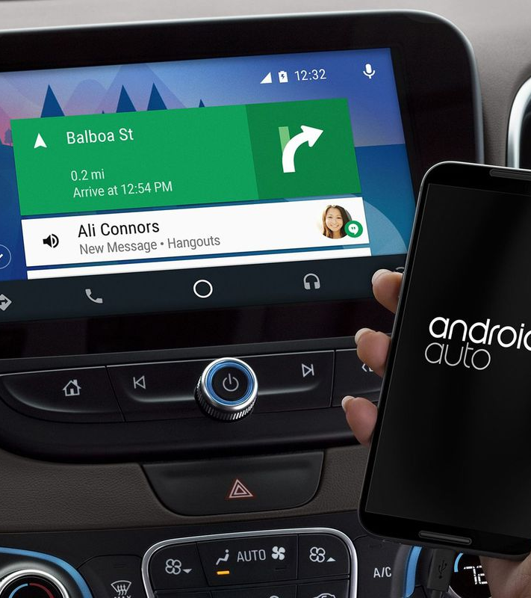
Car Players

Slide 14
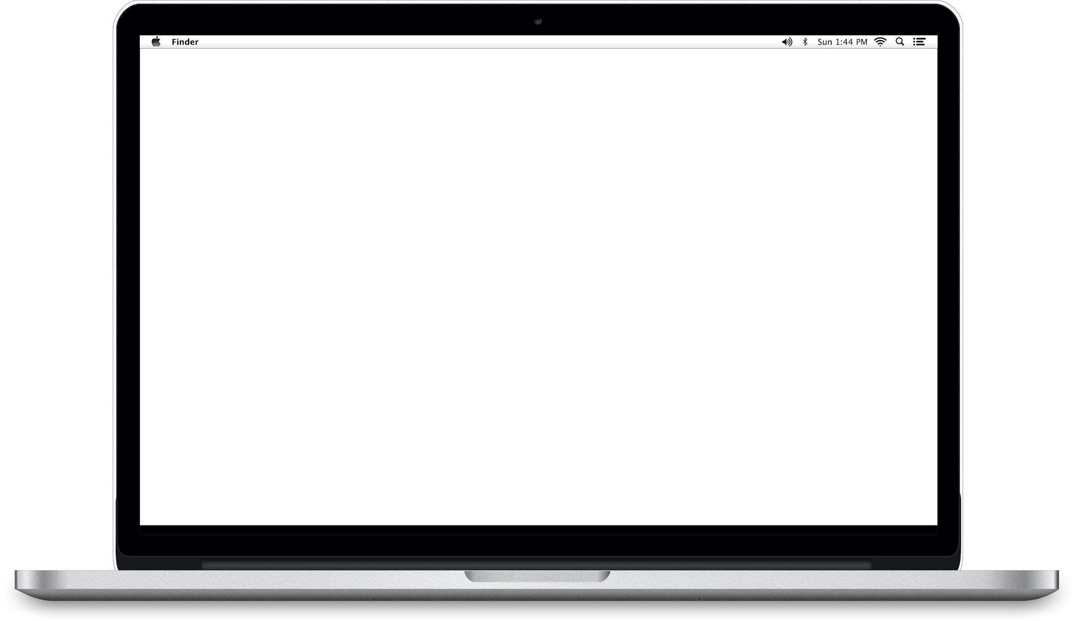
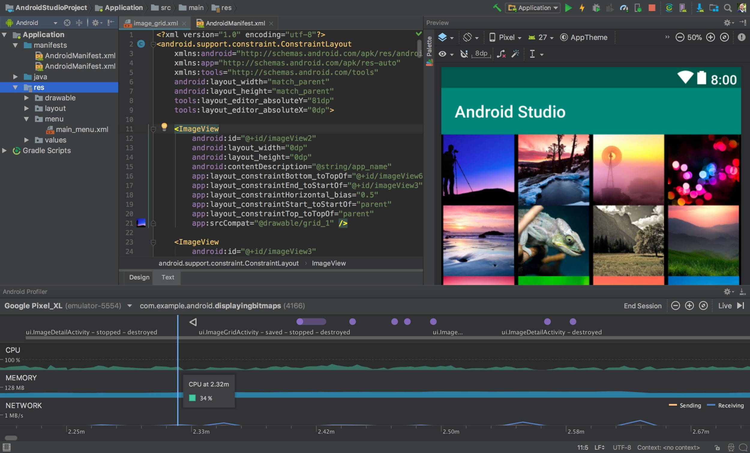
Android
Mobile Application
Development
By Fidenz Technologies

